Slide 1
I have Html+javascript multiple choise quiz (MCQ) which works offline
I want 2 simple tasks:
1- student can save his name & student number in his test so when he save it at the end as pdf we can print the final results.
2- add (save as pdf) to the final result screen and remove the exit button (Name of saved file must be student number) which can be made by name of page maybe.
pdf should show student details and score
if possible to show percentage from 100 would be bonus
the exam in local (offline) computer
so the (pdf save script) should work offline
here is video maybe helpful
page to pdf js
https://www.youtube.com/watch?v=DV2tAG5E-F0

Slide 2
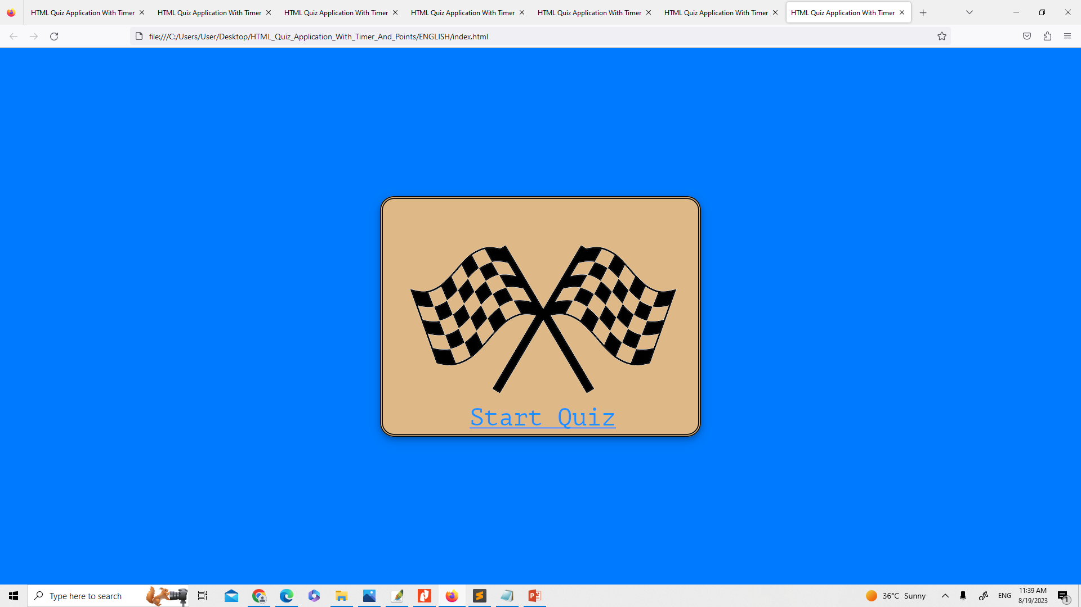
Student Name:
Student Number:
Date:
Full Name
1st tasks to be done
1
Employee Number
Automatically from PC date

Slide 3
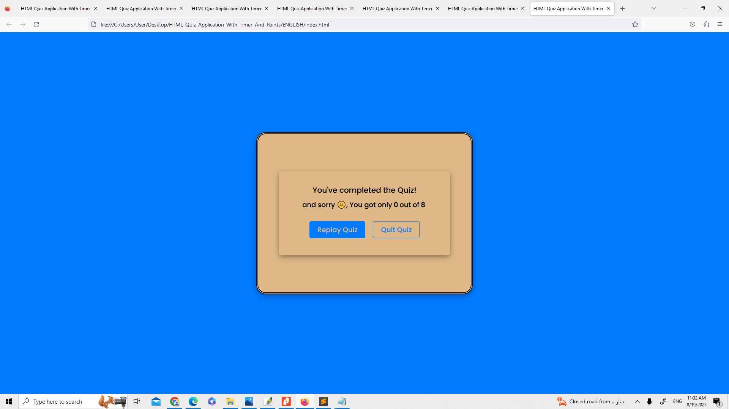
Student Name:
Student Number:
Date:
Mohamed Eisa Nagem
12970
DD/MM/YYYY
Remove this button
2
2nd tasks to be done
Save as PDF

